Slide 1
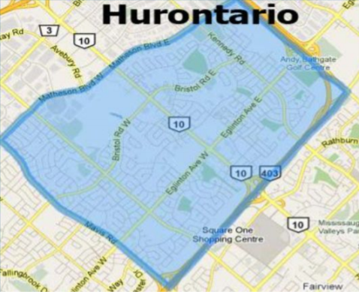
Introduction
-Group 1 (Farrukh, Marko, Rayyan)
-Neighbourhood of Hurontario
-Literature Review Sections
-Discussion in context of Hurontario
-Main Theme: New Urbanism

Slide 2
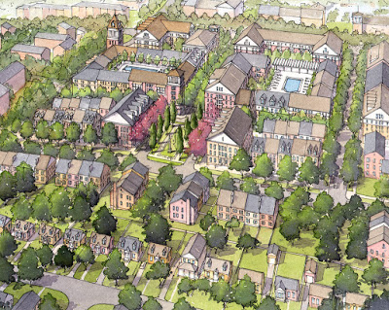
New Urbanism
New Urbanism: An environmental friendly movement promoting sustainable neighbourhoods by creating pedestrian friendly spaces and providing a wide variety of housing and jobs. (Grant)
Goals:
Reduce the dependence on cars by making the neighbourhood more walkable
Equipping neighbourhood with a wide variety of houses, jobs and commercial sites
Implications:
Usage of public transport reduces air pollution
Fewer accidents
Promotes healthy lifestyle

Slide 3
Section 1 (Key Arguments)
A better built landscape can reduce traffic crashes (Dumbaugh)
Home zones provide a safer and more enjoyable neighbourhood for kids as well as adults(Woonerf design) (Hamidi)
Several issues with the urban design (Sideris)
Climate, , immigration
Urbanisation of a city can result in less social and income diversity in the area (Miles)

Slide 4
Achieving New Urbanism in Post-WWII Cities
-Motivation for achieving it:
-Dispersed suburbanism causes vehicle-ownership to prereq. for working (Filion)
-Post-WWII Cities were built when DS was the norm (Filion)
-Disadvantages low-income residents, gentrifies them (Filion)
-New Urbanist areas are more desirable to live in (Piatkowski, Marshall)
-Generally better street ambience, safety (Piatkowski, Marshall)

Slide 5
Achieving New Urbanism in Post-WWII Cities
-Significant economic barriers to implementing New Urbanism
-Consumer preferences pressure developers to include driveways (Grant)
-Political barriers also present
-Council workers having prior experience in development industry (Grant)
-Implementation New Urbanism is dependent on public transportation (Rice)

Slide 6
Residents behavior, lifestyle choices with regards to New urbanism
Rapid sprawling development patterns (characteristic of most Western societies) individual residential preferences (Peter Howley, 2009a)
Developed societies have sustainable urban development (Peter Howley, 2009a)
Increase in residential density may be associated with adverse quality of life
Thus, environmental benefit would be outweighed by the quality of life (Peter Howley, 2009b)
Goal is to reduce pollution and habitat loss, but people don’t want to make sacrifices (Peter Howley, 2009b)

Slide 7
Residents behavior, lifestyle choices with regards to New urbanism
Housing satisfaction will play crucial role in overall quality of life and consumer housing choices (Peter Howley, 2010)
Policy prescriptions favour urban compaction policies to counter urban decentralisation (Peter Howley, 2010)
Compact city policy aims to reduce pollution & habitat loss (Peter Howley, 2010)
Communities are commonly associated with new urbanism, smart growth and sustainable development (Grant, Perrott)
Calls for housing over stores and housing in the areas dominated by retail use have appeared commonly over past two decades (Grant, Perrott)

Slide 8
Discussion
-Making Hurontario more complete will be a means of achieving New Urbanism
-adding roads, high-density residences, amenities
-Highly applicable to Hurontario, as the neighbourhood widely demonstrates DS
-Implementing it is relatively feasible, given the appropriate transportation
-New Urbanism is generally about achieving the common good
-social, environmental benefits

Slide 9
Conclusion
-Strong need for New Urbanism to be implemented in Post-WWII cities
-Significant resistance to doing so, however there are also pressures in favor of it
-Lowering commute time, making housing affordable
-It has become difficult to create communities that meet consumer needs while also being sustainable
-Due to policy implementation and the characteristics of society

Slide 10
References
Dumbaugh, E. & Li, W. (2010) Designing for the Safety of Pedestrians, Cyclists, and Motorists in Urban Environments. Journal of the American Planning Association, 77(1): 69-88.
Filion, P. (2015) Suburban Inertia: The Entrenchment of Dispersed Suburbanism. International Journal of Urban and Regional Research, 39(3): 633-640.
Grant, J.L. (2009) Theory and Practice in Planning the Suburbs: Challenges to Implementing New Urbanism, Smart Growth and Sustainability Principles. Planning Theory and Practice, 10(1): 11-33.
Grant, J.L. & Perrott, K. (2011) Where is the Café? The Challenge of Making Retail Uses Viable in Mixed-use Suburban Developments. Urban Studies, 48(1): 177-195.
Hamidi, S., Ewing, R., Preuss, I., & Dodds, A. (2015) Measuring Sprawl and Its Impacts: An Update. Journal of Planning Education and Research, 35(1): 35-50.
Howley, P. (2010) ‘Sustainability versus Liveability’: An Exploration of Central City Housing Satisfaction. International Journal of Housing Policy, 10(2): 173-189.
Howley, P., Scott, M. & Redmond, D. (2009a) An examination of residential preferences for less sustainable housing: Exploring future mobility among Dublin central city residents. Cities, 26(1): 1-8.
Howley, P., Scott, M., & Redmond, D. (2009b) Sustainability versus liveability: an investigation of neighbourhood satisfaction. Journal of Environmental Planning and Management.52(6): 847-864.
Loukaitou-Sideris, A. (2012) Addressing the Challenges of Urban Landscapes: Normative Goals for Urban Design. Journal of Urban Design, 17(4): 467-484.
Miles, R., Song, Y., & Frank, L. (2010) Social diversity and construction era of neighbourhoods with traditional design features: Portland and Atlanta compared. Journal of Urbanism: International Research on Placemaking and Urban Sustainability, 3(1): 19-38.
Piatkowski, D. & Marshall, W.E. (2014) ‘New’ versus ‘Old’ Urbanism: A comparative analysis of travel behaviour in large-scale New Urbanist communities and older, more established neighbourhoods in Denver, Colorado. Urban Design International, 19(3):228-245.
Rice, L. (2010) Retrofitting suburbia: is the compact city feasible? Urban Design and Planning, 163(4): 193-204.
“What Is New Urbanism?” CNU, Congress for the New Urbanism, 19 Dec. 2019, https://www.cnu.org/resources/what-new-urbanism.

